Slide 1
Covid-19 Vaccine Distribution System
Let’s live fear free

Slide 2
Introduction
In the upcoming months, everyone would like to get vaccinated asap.
This app will help patients book appointments, Hospitals manage their inventory and governing body approve vaccination supplies to the hospitals.
Not only this, the app has also a unique feature which would let patients book appointments using the app based on their location
The governing body will be able to see the current inventory of the hospitals to make sure that they are not running out of the vaccination.

Slide 3
Design
The application has three entities, provider, controller and patient.
The covid vaccine distribution system enables patient to book appointments based on their location. For finding out the latitude and longitude of the patient . The app uses inbuilt component of Xcode called core location.
The patient also has an option to choose hospital based on their location. App sorts all the hospital which are closer to patient’s location in an ascending order. The functionality has been implemented by using MapKit, Core location and CL geocoder

Slide 4
Design (Cont.)
The app is designed to reduce the tedious task of hospital employees to manage the inventory. To display the entities and other components. The components used are table view, date picker, picker view, text boxes and buttons, image view.
The date to get the covid vaccine can be selected by the patient. This functionality has been used by Picker view, date picker.

Slide 5

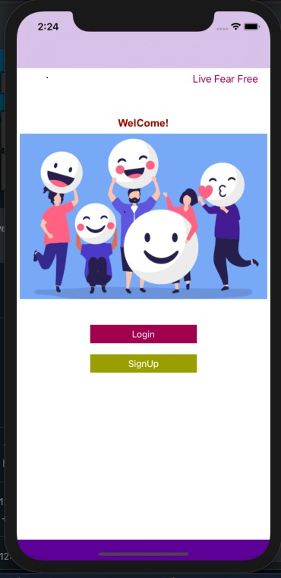



Landing screen

Slide 6
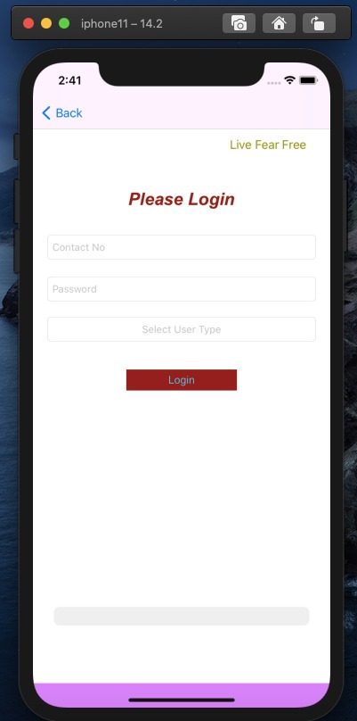
Login screen

Slide 7
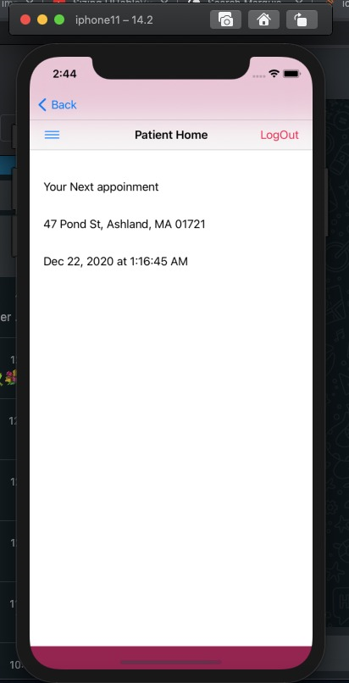
Patient Home – Page

Slide 8
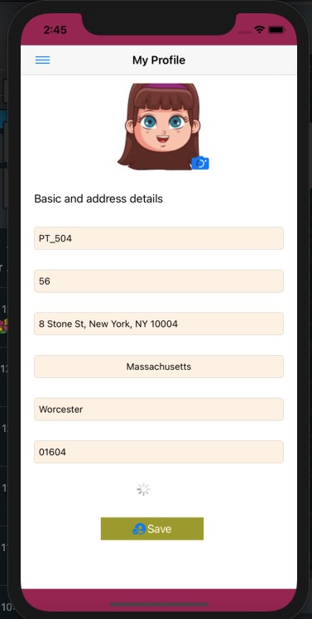
Patient profile

Slide 9
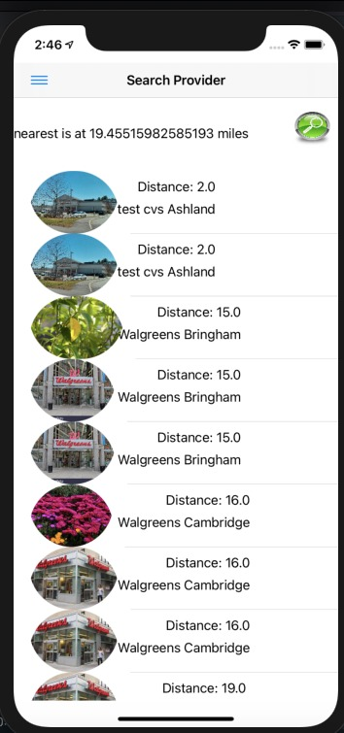
Hospital search Screen

Slide 10
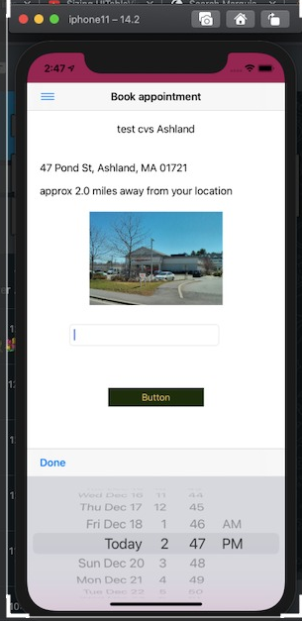
Book Appointment

Slide 11
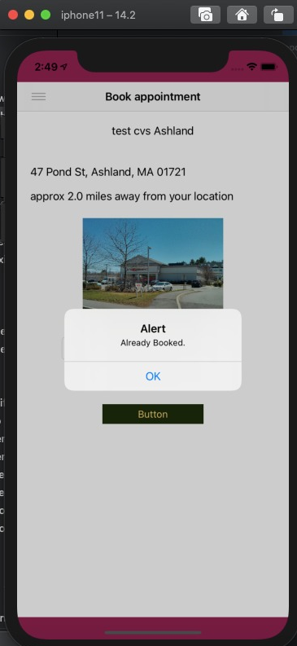
Booking Confirmation

Slide 12
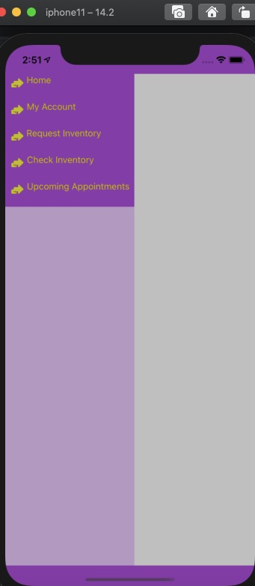
Provider Menu

Slide 13
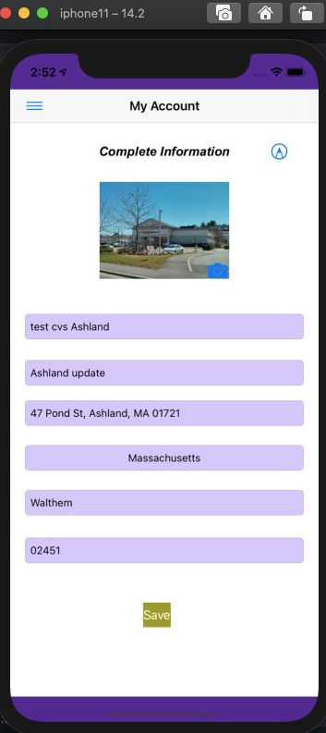
Provider Account

Slide 14
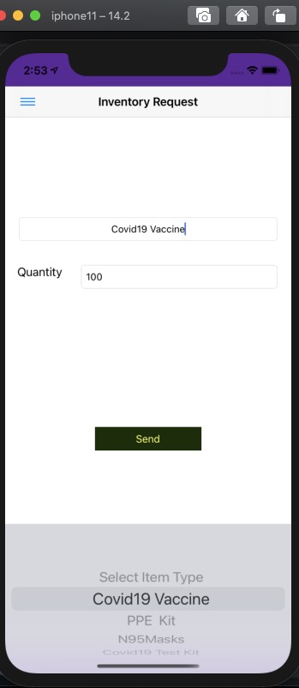
Inventory item request

Slide 15
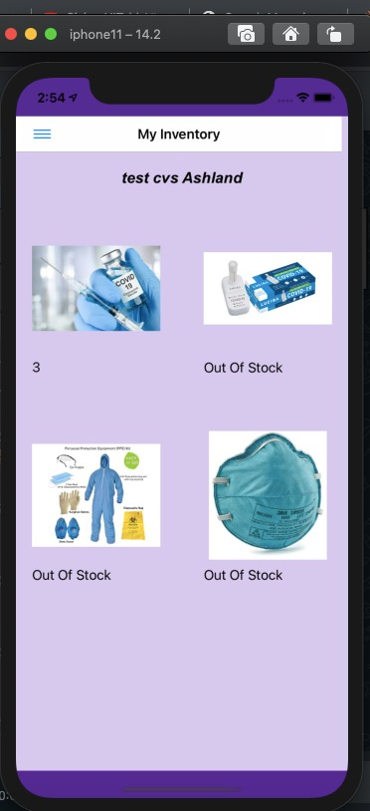
Check Inventory

Slide 16
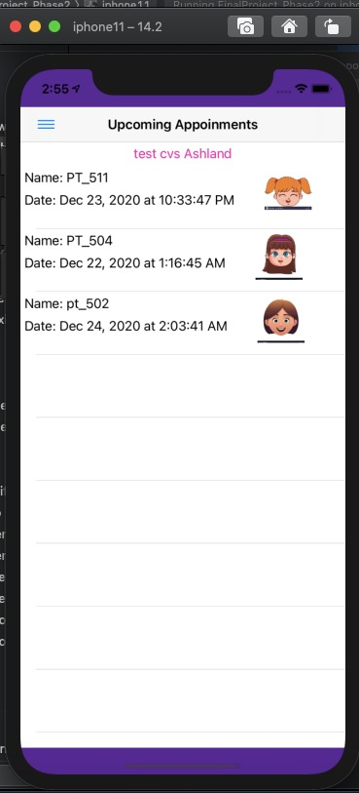
Upcoming Appointments

Slide 17
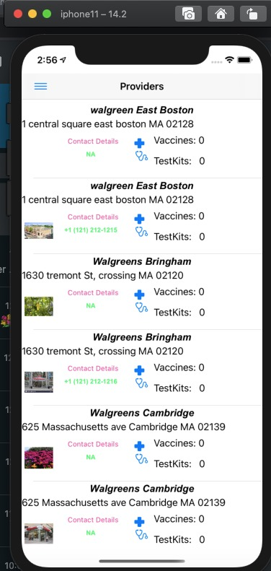
List of providers

Slide 18
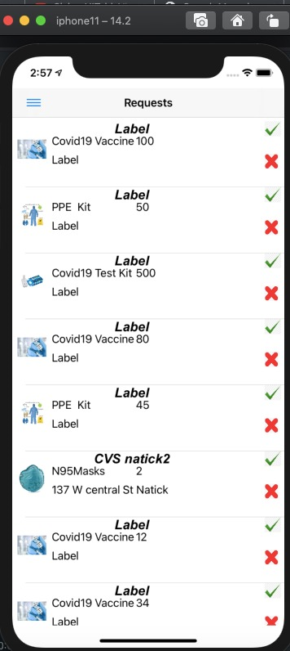
Pending Approvals

